Slide 1

Report Writing and Reflective Writing
Centre for Learning and Study Support (CLaSS)

Slide 2
Session Plan
Planning and structuring a report
Writing reflectively

Slide 3

What makes a good report?
Provides information in a clear and concise form
Is clearly structured
Presents your analysis of the situation
Evidence (referenced)
Limitations and strengths
of evidence
Provides
Recommendations/
conclusions
based on analysis of
evidence

Slide 4
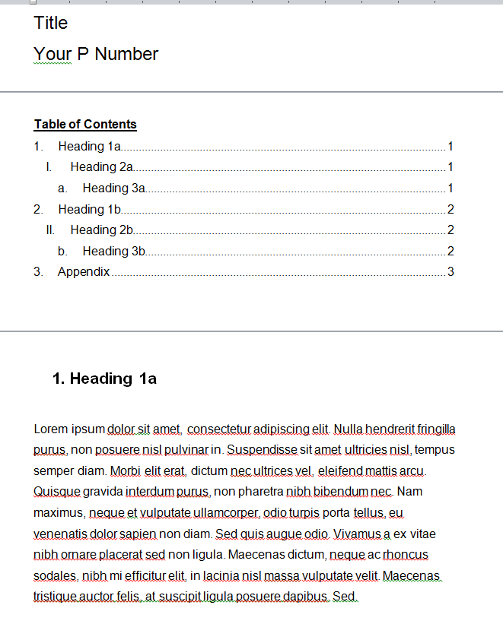
The Structure of Your Report
Your report template
“Reports are typically written for your boss who has neither the time nor interest to read the report thoroughly.
This being the case you need to create your report such that it makes its points in as fast and clear a manner as possible. Reports need to be written for random access and speed of reading.”

Slide 5
Critical analysis in reports
Highlight different perspectives on your topic E.g. for your social impact study, include ‘personal, national and global implications of the use of technology’
Compare different sources and explain differences (if any)
Evaluate the implications of your findings (for the stakeholders, research, practice etc.).

Slide 6
Present Data in Tables and Figures
Label clearly any figures (graphs, illustrations, maps etc.) and/or tables and cite the source.
These graphics should relate to the text of your report:
For example: Figure 1 shows that the population of Bandung has increased dramatically since 1890, or
The population of Bandung has increased dramatically since 1890 (see Figure 1).

Slide 7
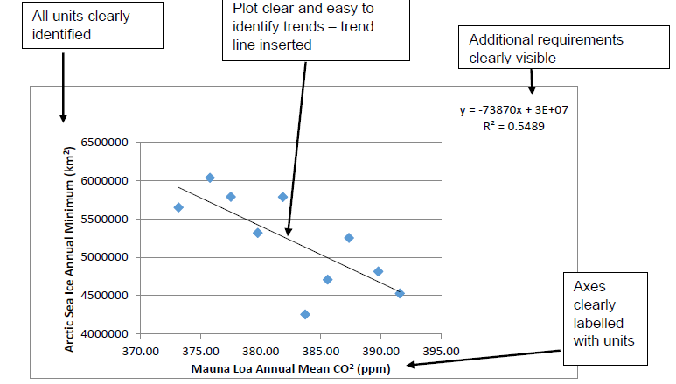
Sample Figure (HarperAdams University 2015)
Figure 1 Relationship between Mauna Loa Annual Mean CO2 (ppm) and Arctic Sea Ice Annual Minimum (km2) (Adapted from NOAA ESRL 2012)

Slide 8
Appendix/ces
Appendices contain material which is relevant to the report, but would otherwise disrupt its flow, if contained in the main body.
Appendices may contain, for example, raw data and calculations, interview questions, a glossary of terms, or other information readers may require.
If there is more than one section, give each appendix a label (Appendix A) and title the section Appendices.

Slide 9
Objectivity in reports
When writing a report, consider the following elements:
Your audience
Objectivity of voice: write in the third person or using the passive voice as in the following example:
‘A series of experiments was conducted.’
Not: ‘I conducted a series of experiments.’
Avoid giving personal opinions, or unnecessary detail.

Slide 10
Activity
Read the extracts from reports.
In each case identify the main problem with the writing style, then rewrite the problematic sentences so they are more suitable for an academic report.
(Adapted from Learn Higher (2017))

Slide 11
Sample solution
Example 1
This style is overly complex and wordy ("aforementioned" and "systemized"). It manages to say very little and could be condensed to a single sentence - saving 38 empty words.
A better version:
The results were collated, processed, and then analysed using the appropriate statistical programme.

Slide 12
Sample solution
Example 2:
The style is too informal, as there are colloquial expressions from everyday speech ("go down the street") and also contractions of words ("can't" instead of "cannot"). The method is not very scientific and it would be better to explain why more residents and another location needs to be found. The writing style is also personal ("If we can't find..."), so it may be more appropriate to rephrase it in the third person.
A better version:
The questionnaire will be carried out in the public space next to the Town Hall, where local residents can be found and stopped. If there are not enough residents to complete the required sample, an alternative location will be found where there are more passing residents, for example in the shopping centre.

Slide 13
What are the differences between (objective)report writing and reflective writing?

Slide 14
Differences
Reflective Writing
(Standard) Report Writing
Personal
You can use the first person
Give personal feelings and views
Bring in the subjective
Draw upon your own experience
State your main insights based on experience
Objective
You do not usually use the first person
Construct an argument based on analysis and evidence
Maintain an objective stance
Use information from a variety of sources
Present a balanced perspective

Slide 15
Objective or reflective?
The report must have the following sections:
Social Impact Study (1500 words)
Discussion of CV Development (Include your latest CV in the Appendix)
The life cycle of your allocated part of the system (How did it evolve and why?)
Critical Review of your Project Performance (What would you do differently on your next project?)
Critical Review of the Module (What worked and what didn’t work in the module)
Other sections / subsections may be added as you see fit
Objective style
Reflective style
Objective style
Reflective style
Reflective style

Slide 16
Critical Review
You are asked to do a “Critical Review” of...
The Module
Your Own Performance
This means doing some Critical Reflection...
... then turning this into writing

Slide 17
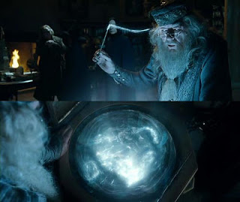
What is reflection?
“…the process of looking back on what has been done and pondering on it and learning lessons from what did or did not work…. (Conway 1994)

Slide 18
Reflection Requires You To:
Make connections
between what you already know and what you are learning,
between theory and practice
between what you are doing and how and why you do it.
Become an active and aware learner
become more engaged, take responsibility for your own learning and understand how you learn best

Slide 19
Reflect on mistakes and successes
Reflecting on mistakes can help you avoid repeating them.
At the same time, reflecting on your discoveries helps identify successful principles to use again.

Slide 20
Elements of Critical Reflection
Critical reflection usually contains:
Description (e.g. what happened?)
Analysis (why? So what?)
Plans for the future (e.g. what next?)
It can be thought of as part of a
cycle of learning
What?
So what?
What next?
Borton 1970

Slide 21
Step One – Identify Aspects to Reflect on
Identify an experience or event (a ‘critical incident’)
Consider what was outstanding or meaningful, negative or positive?

Slide 22
Step Two– Analyse the Experience or Event
Conduct a critical analysis
Consider the significance of the situation from a variety of perspectives
Support your reflections with further research using a variety of sources

Slide 23
Step Three– Evaluation: What have you learned?
Good reflection requires you to identify a changed conceptual perspective, i.e. a different way of looking at the situation than before you started reflection on it
Identify what changes you would make if you faced the situation again.
Identify any areas you need to learn about to better deal with a similar situation.
You may be required to come up with an action plan.

Slide 24
Sample Reflective Paragraph
Specific tasks were shared out amongst members of my team. Initially, however, I did not feel the tasks were equally difficult. Cooperation between group members was at risk because of this perception of unfairness. Social interdependence theory recognises a type of group interaction called ‘positive interdependence’, meaning cooperation (Johnson and Johnson 1993, cited by Maughan and Webb 2001), and many studies have demonstrated that “cooperative Learning experiences encourage higher achievement” (Maughan and Webb 2001). Ultimately, our group achieved a successful outcome, but to improve the process, we perhaps needed a chairperson to help encourage cooperation when tasks were being shared out. In future group work, on the course and at work, I would probably suggest this.

Slide 25
Sample Reflective Paragraph
Specific tasks were shared out amongst members of my team. Initially, however, I did not feel the tasks were equally difficult. Cooperation between group members was at risk because of this perception of unfairness. Social interdependence theory recognises a type of group interaction called ‘positive interdependence’, meaning cooperation (Johnson and Johnson 1993, cited by Maughan and Webb 2001), and many studies have demonstrated that “cooperative Learning experiences encourage higher achievement” (Maughan and Webb 2001). Ultimately, our group achieved a successful outcome, but to improve the process, we perhaps needed a chairperson to help encourage cooperation when tasks were being shared out. In future group work, on the course and at work, I would probably suggest this.
Notes:
Description, Analysis, Evaluation

Slide 26
Some strategies to get started
Options include
Free-writing or Speed Writing
Peer discussion
Talking to yourself (and recording)
Drawings and diagrams
See DMU HEAT: http://www.library.dmu.ac.uk/Support/Heat/index.php?page=469
Activity: 2 minutes of speed writing on:
“How helpful has this module been for you so far? What have you learned that you might use in the future?”
GOLDEN RULE: don’t stop writing!
2 minutes
End

Slide 27




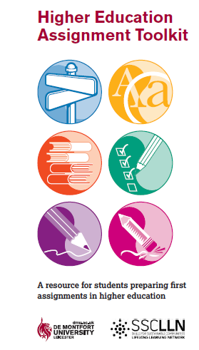
Centre for Learning and Study Support Enhancing academic practice, writing development and professional skills
Tutorials and Drop-in
Workshops
Workshops run regularly: Keep an eye out on blackboard and MyDMU to see our upcoming sessions
To sign up go the library what’s on page: www.library.dmu.ac.uk/Home/Calendar
Book a 30 minute one-to-one appointment to discuss any aspect of your study or work: visit the Library “What’s on?” page to book.
Just a quick question? Drop in every Monday, Wednesday, Friday 2-3pm or Tuesday, Thursday 5-6pm in the LDZ Kimberlin library where CLaSS will be waiting to answer your question!
Guides
HEAT, “Focus On” and more…
To view our online resources go to: www.library.dmu.ac.uk/link/CLASS
To help fit the pieces of your study together visit: www.library.dmu.ac.uk/link/CLASS

